Slide 1




IPL MATCHES
SQL ANALYSIS

Slide 2

KPIs Cover in all analysis of IPL_Maches and IPL_BAL
1. Create and Import IPL Match, and ipl_ball and create the table name of Matches from Ipl_matches and Deliveries from IPl_ball.
2. Create and Import IPL Match, and ipl_ball and create the table name of Matches from Ipl_matches and Deliveries from IPl_ball
3. TEAMS TOSS ANALYSIS AND TOSS WIN PERCENTAGE
4. Total matches played in each year.
5. TOURNAMENT ANALYSIS according to deliveries table.
6. TOTAL NUMBER OF MATCH by the Years and totals boundries with Total Runs and Total wicket
7. Total of Match winn by team.
8. Top 20 Batsmen of Strick rate, Batting average, Boundary(4,6),
Balls faced, Runs Scored
9. Highest number of sixes by bastman.
10. Highest number of FOURS by bastman.
11. Any player with max players of match award as Man of Match.
12. Balls taken to hit century Balls taken to hit century
13. Top 10 bowler name by the played matches and took the wickets
14. Top 20 Bowlers of economy rate, bowling average
stricke rate(bowling) wickets taken, balles bowled
15. Top 20 All-rounders Batting strick rate, bowling economy rate, batting and bowling
averages, wicket taken, run scored
16. Top 20 with player good average played at least all IPL seasons.
17. Top 20 highest strike rate
18. All Bowler who bowled in ipl with complete stets on name
19. who has taken maximum catches.
20. WINNER, RESULT BY RUNS OR WICKET
Additional question from final assessment
1. Create table deliveries_v02 with all the columns of the table ‘deliveries’ and an additional.
2.column ball_result containing values boundary, dot or other depending on the total_run (boundary for >= 4, dot for 0 and other for any other number). the count of cities that have hosted an IPL match.
3. Write a query to fetch the total number of boundaries and dot balls from the deliveries_v02 table.
4. Write a query to fetch the total number of boundaries scored by
each team from the deliveries_v02 table and order it in descending order of the number of boundaries scored.
5. Write a query to fetch the total number of dot balls bowled by each
team and order it in descending order of the total number of dot balls bowled.
6. Write a query to fetch the total number of
dismissals by dismissal kinds where dismissal kind is not NA.
7. Write a query to get the top 5
bowlers who conceded maximum extra runs from the deliveries table.
8. Write a query to create a table named deliveries_v03 with all the
columns of deliveries_v02 table and two additional column (named venue and match_date)
of venue and date from table matches.
9. Write a query to fetch the total runs scored for
each venue and order it in the descending order of total runs scored.
10. Write a query to fetch the year-wise total runs scored at
Eden Gardens and order it in the descending order of total runs scored.

Slide 3
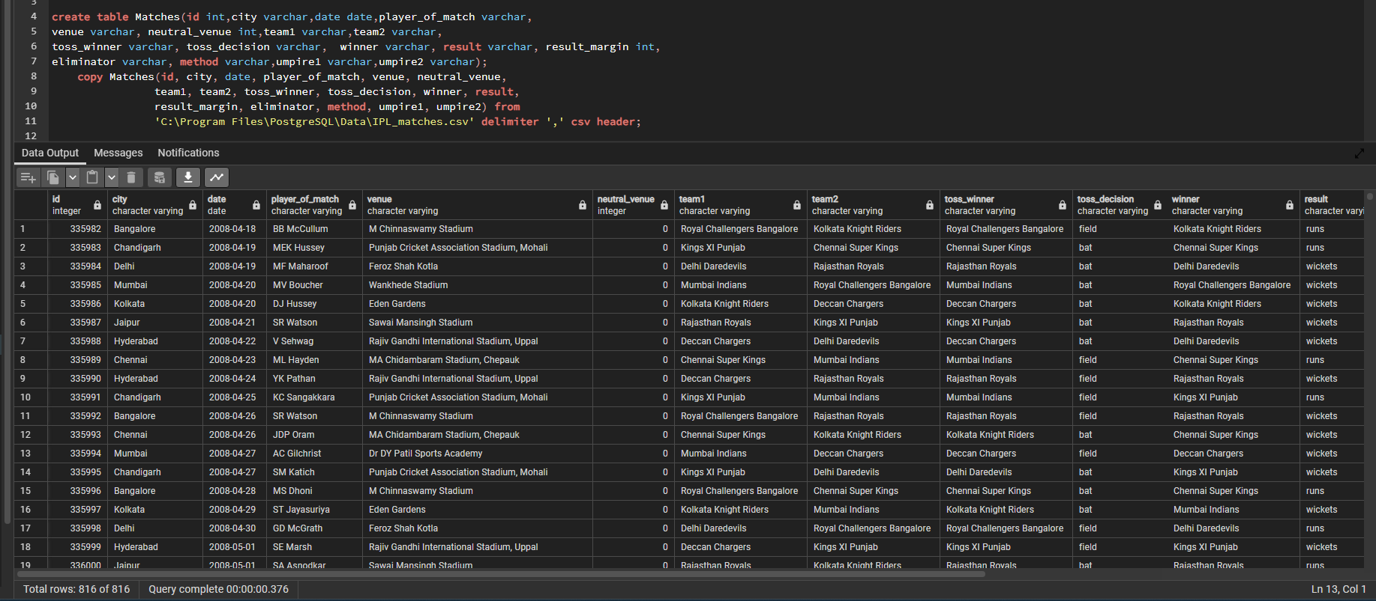
1. Create and Import IPL Match, and ipl_ball and create the table name of Matches from Ipl_matches and Deliveries from IPl_ball.
create table Matches(id int,city varchar,date date,player_of_match varchar,
venue varchar, neutral_venue int,team1 varchar,team2 varchar,
toss_winner varchar, toss_decision varchar, winner varchar, result varchar, result_margin int,
eliminator varchar, method varchar,umpire1 varchar,umpire2 varchar);
copy Matches(id, city, date, player_of_match, venue, neutral_venue,
team1, team2, toss_winner, toss_decision, winner, result,
result_margin, eliminator, method, umpire1, umpire2) from
'C:\Program Files\PostgreSQL\Data\IPL_matches.csv' delimiter ',' csv header;

Slide 4

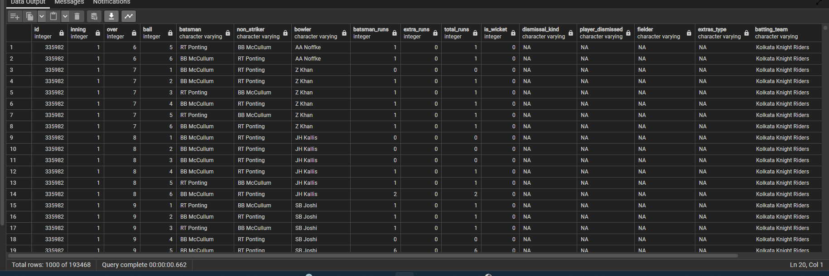
2. Create and Import IPL Match, and ipl_ball and create the table name of Matches from Ipl_matches
and Deliveries from IPl_ball
create table deliveries(id int,inning int,over int, ball int,
batsman varchar,non_striker varchar,bowler varchar,batsman_runs int, extra_runs int,total_runs int,
is_wicket int,dismissal_kind varchar,player_dismissed varchar,fielder varchar, extras_type varchar,batting_team varchar,bowling_team varchar);
copy deliveries from 'C:\Program Files\PostgreSQL\Data\IPL_Ball.csv' delimiter ',' csv header;

Slide 5
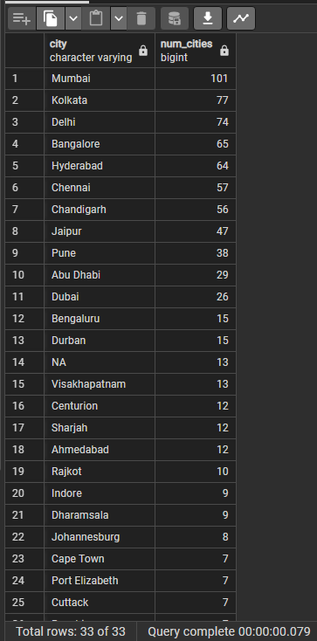
Additional question from final assessment
1. Get the count of cities that have hosted an IPL match
SELECT city, count(city) AS num_cities
FROM Matches
GROUP BY city
ORDER BY num_cities DESC;

Slide 6

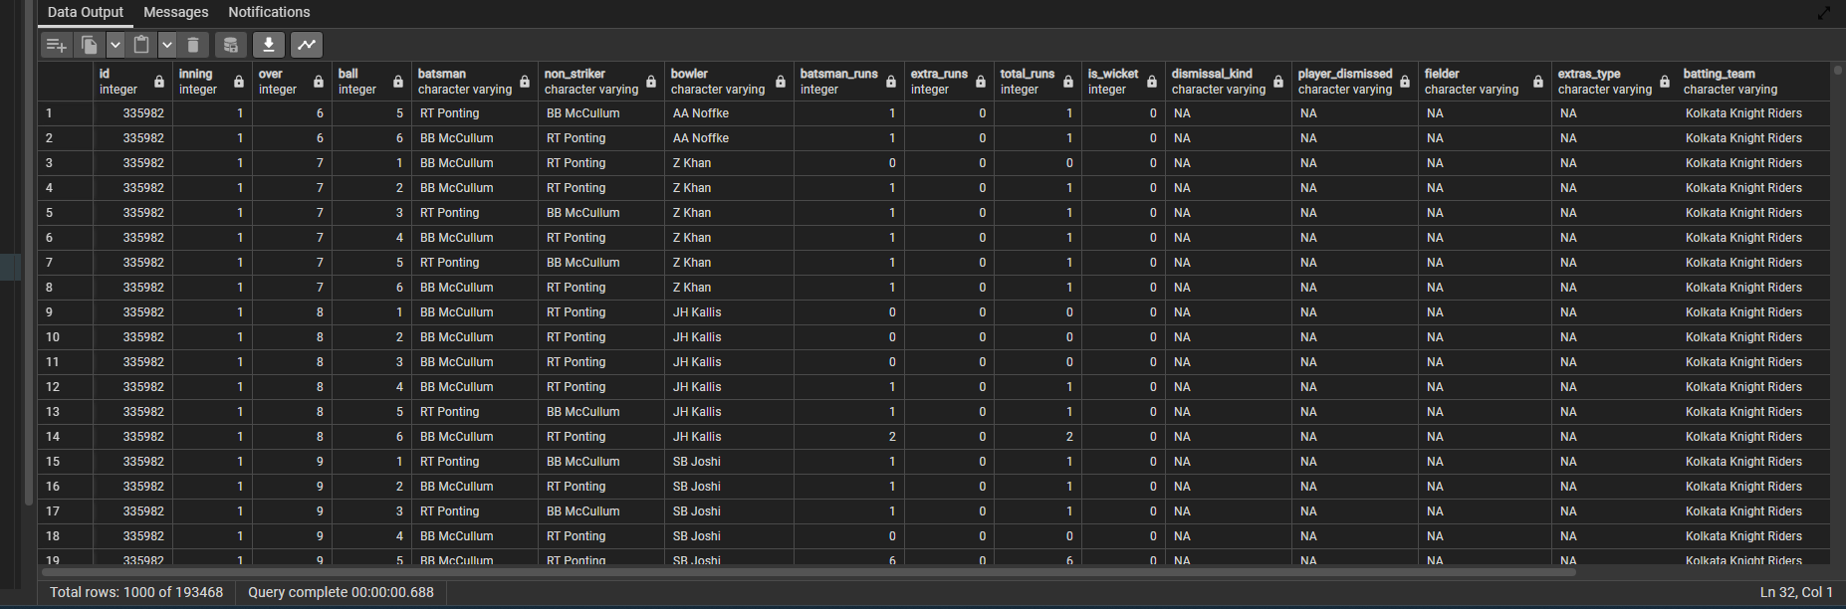
2. Create table deliveries_v02 with all the columns of the table ‘deliveries’ and an additional
column ball_result containing values boundary, dot or other depending on the total_run
(boundary for >= 4, dot for 0 and other for any other number).
CREATE TABLE deliveries_v02 AS
SELECT *,CASE WHEN total_runs >= 4 THEN 'boundary'
WHEN total_runs = 0 THEN 'dot'
ELSE 'other' END AS ball_result
FROM deliveries;
Select *from deliveries_v02

Slide 7
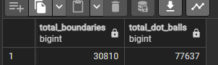
3. Write a query to fetch the total number of boundaries and dot balls from the deliveries_v02 table.
SELECT
SUM(CASE WHEN batsman_runs = 4 OR batsman_runs = 6 THEN 1 ELSE 0 END) AS total_boundaries,
SUM(CASE WHEN batsman_runs = 0 THEN 1 ELSE 0 END) AS total_dot_balls
FROM
deliveries_v02;

Slide 8

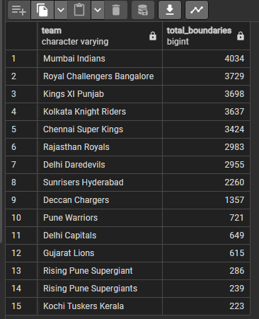
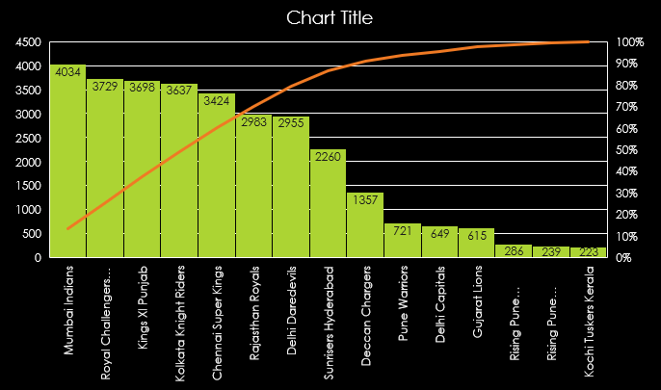
4. Write a query to fetch the total number of boundaries scored by
each team from the deliveries_v02 table and order it in descending order of the number of boundaries scored.
SELECT batting_team AS team,
SUM(CASE WHEN batsman_runs = 4 OR batsman_runs = 6 THEN 1 ELSE 0 END) AS total_boundaries
FROM deliveries_v02
GROUP BY batting_team
ORDER BY total_boundaries DESC;

Slide 9

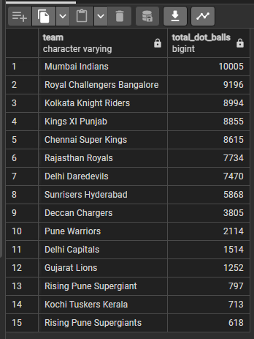
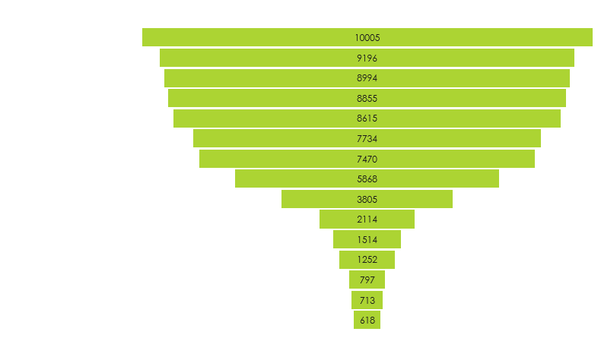
5. Write a query to fetch the total number of dot balls bowled by each
team and order it in descending order of the total number of dot balls bowled.
SELECT bowling_team AS team,
SUM(CASE WHEN batsman_runs = 0 THEN 1 ELSE 0 END) AS total_dot_balls
FROM deliveries
GROUP BY bowling_team
ORDER BY total_dot_balls DESC limit 15;

Slide 10
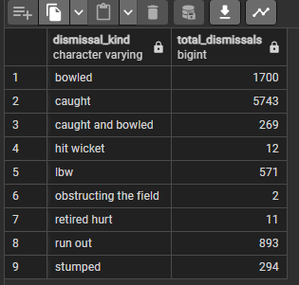
6. Write a query to fetch the total number of
dismissals by dismissal kinds where dismissal kind is not NA.
SELECT dismissal_kind,
COUNT(*) AS total_dismissals
FROM deliveries
WHERE dismissal_kind <> 'NA'
GROUP BY dismissal_kind;

Slide 11

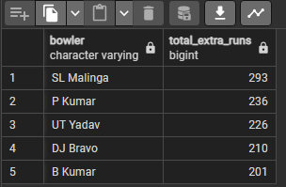
7. Write a query to get the top 5
bowlers who conceded maximum extra runs from the deliveries table.
SELECT bowler,
SUM(extra_runs) AS total_extra_runs
FROM deliveries
GROUP BY bowler
ORDER BY total_extra_runs DESC
LIMIT 5;

Slide 12
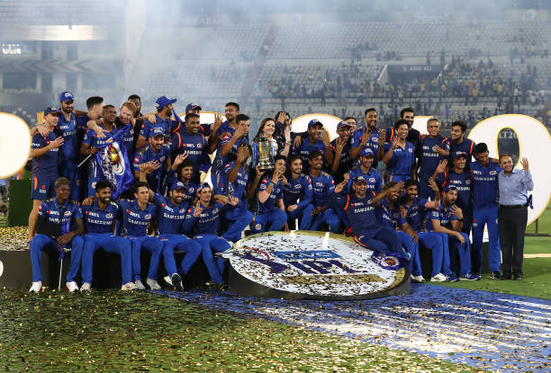
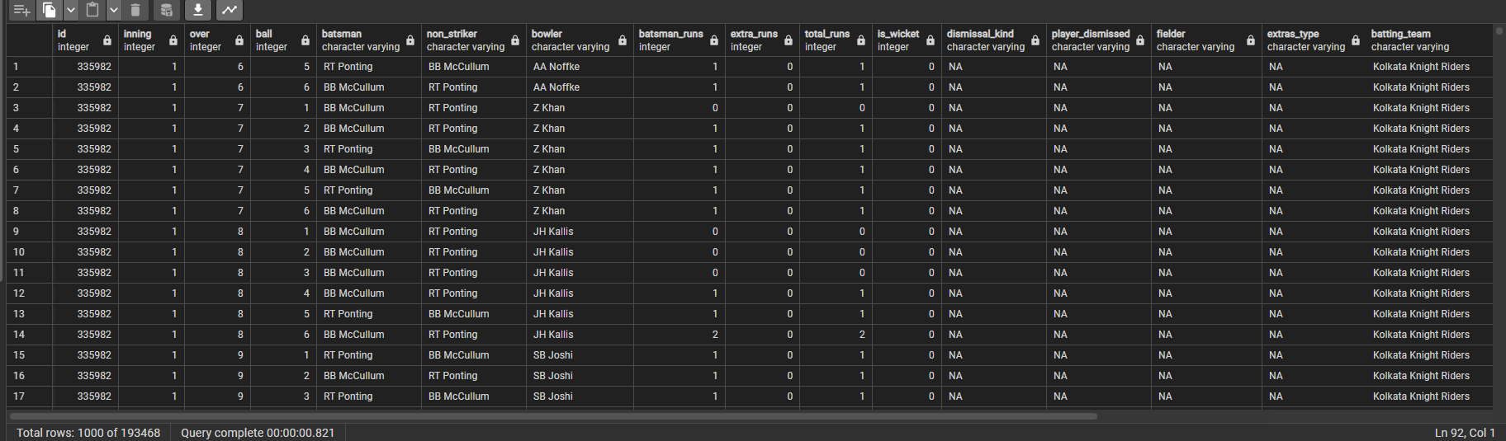
8. Write a query to create a table named deliveries_v03 with all the
columns of deliveries_v02 table and two additional column (named venue and match_date)
of venue and date from table matches.
CREATE TABLE deliveries_v03 AS
SELECT d.*, m.venue,
m.date AS match_date
FROM deliveries_v02 d
JOIN matches m ON d.id = m.id;

Slide 13

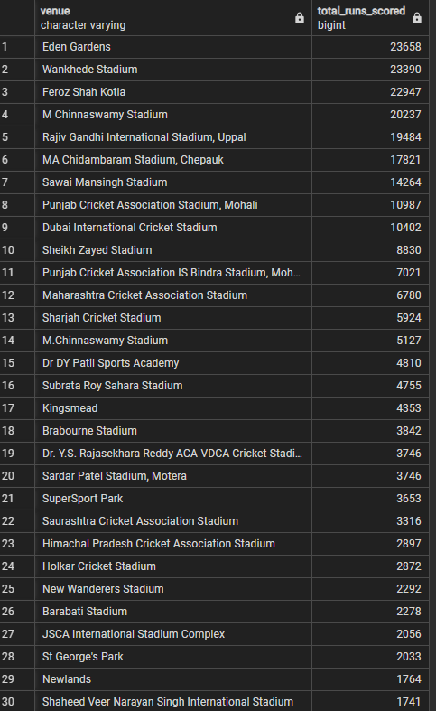
9. Write a query to fetch the total runs scored for
each venue and order it in the descending order of total runs scored.
SELECT venue, SUM(total_runs) AS total_runs_scored
FROM matches m
JOIN deliveries b ON m.id = b.id
GROUP BY venue
ORDER BY total_runs_scored DESC;

Slide 14

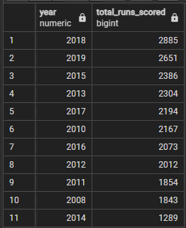
10. Write a query to fetch the year-wise total runs scored at
Eden Gardens and order it in the descending order of total runs scored.
SELECT EXTRACT(YEAR FROM m.date) AS year,
SUM(b.total_runs) AS total_runs_scored
FROM matches m
JOIN deliveries b ON m.id = b.id
WHERE m.venue = 'Eden Gardens'
GROUP BY EXTRACT(YEAR FROM m.date)
ORDER BY total_runs_scored DESC;

Slide 15

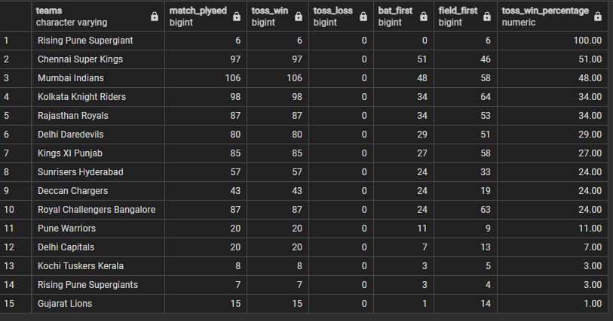
3. TEAMS TOSS ANALYSIS AND TOSS WIN PERCENTAGE
SELECT toss_winner AS TEAMS,
COUNT(DISTINCT ID) AS MATCH_PLYAED,
SUM(CASE WHEN toss_decision = 'bat' THEN 1 ELSE 0 END) +
SUM(CASE WHEN toss_decision = 'field' THEN 1 ELSE 0 END) AS TOSS_WIN,
SUM(CASE WHEN toss_decision NOT IN ('bat' , 'field') THEN 1 ELSE 0 END) AS TOSS_LOSS,
SUM(CASE WHEN toss_decision = 'bat' THEN 1 ELSE 0 END) AS BAT_FIRST,
SUM(CASE WHEN toss_decision = 'field' THEN 1 ELSE 0 END) AS FIELD_FIRST,
ROUND(SUM(CASE WHEN toss_decision = 'bat' THEN 1 ELSE 0 END) + SUM(CASE WHEN toss_decision = 'field' THEN 1 ELSE 0
END) / COUNT(DISTINCT ID) * 100, 2) AS TOSS_WIN_PERCENTAGE
FROM MATCHES
GROUP BY toss_winner
ORDER BY TOSS_WIN_PERCENTAGE DESC;

Slide 16
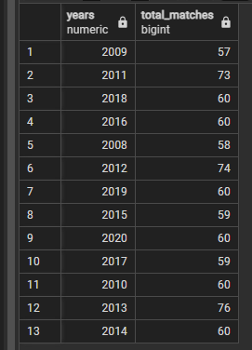
4. Total matches played in each year.
select extract (year from date) as years ,count(id) total_matches
from matches
group by extract (year from date);

Slide 17

5. TOURNAMENT ANALYSIS according to deliveries table.
SELECT COUNT(DISTINCT ID) AS TOTAL_MATCHES_PLAYED,
COUNT(DISTINCT batsman) AS TOTAL_BATSMAN,
COUNT(DISTINCT bowler) AS TOTAL_BOWLERS,
ROUND(SUM(BALL) / 6, 0) AS TOTAL_APPROX_OVERS_BOWLED,
SUM(TOTAL_RUNS) AS TOTAL_RUNS_SCORED,
SUM(BALL) AS TOTAL_BOWLS_BOWLED,
SUM(IS_WICKET) AS TOTAL_NUMBER_OF_WICKETS,
SUM(EXTRA_RUNS) AS TOTAL_EXTRA_RUNS
FROM deliveries;

Slide 18

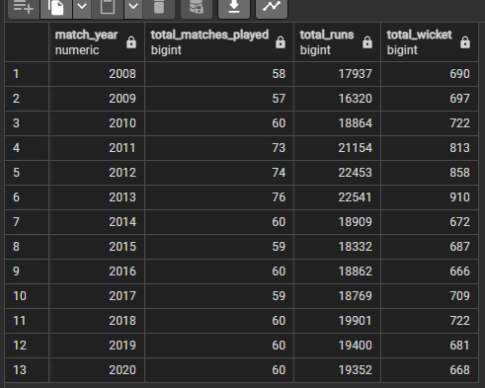
6. TOTAL NUMBER OF MATCH by the Years and totals boundries with Total Runs and Total wicket
SELECT EXTRACT(YEAR FROM m.date) AS match_year,
COUNT(DISTINCT m.id) AS total_matches_played,
SUM(b.total_runs) AS Total_Runs,
COUNT(CASE WHEN b.is_wicket = '1' THEN 1 END) AS Total_wicket
FROM matches m
JOIN deliveries b ON m.id = b.id
GROUP BY match_year
ORDER BY match_year;

Slide 19
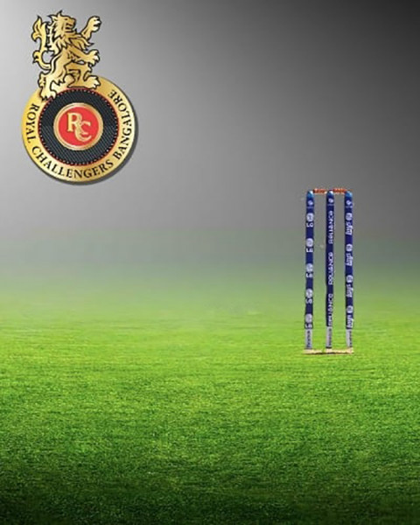
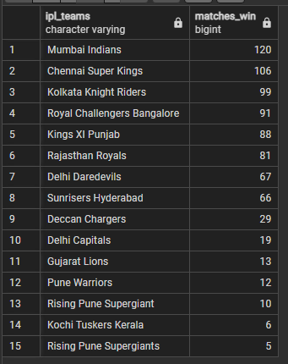
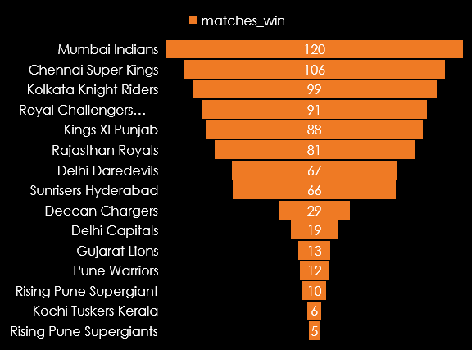
7. Total of Match winn by team.
SELECT DISTINCT WINNER AS IPL_TEAMS, COUNT(WINNER) AS MATCHES_WIN
FROM matches
WHERE WINNER NOT IN ('BAT' , 'FIELD', 'NA')
GROUP BY WINNER
ORDER BY MATCHES_WIN DESC;

Slide 20
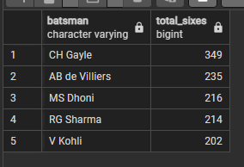
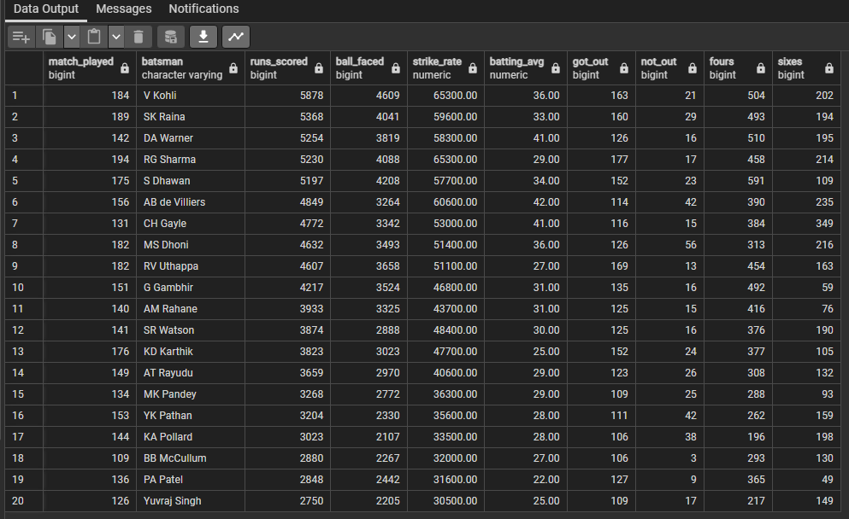
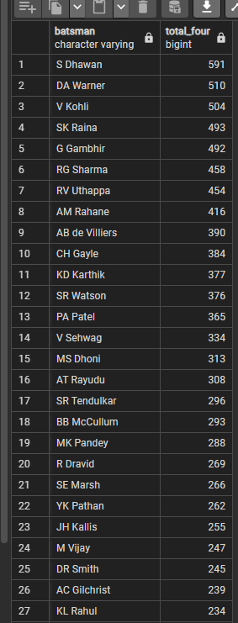
-- 8. Top 20 Batsmen of Strick rate, Batting average, Boundary(4,6),
Balls faced, Runs Scored
SELECT COUNT(DISTINCT id) AS MATCH_PLAYED,
batsman AS BATSMAN,
SUM(batsman_runs) AS RUNS_SCORED,
COUNT(ball) AS BALL_FACED,
ROUND((SUM(batsman_runs) / NULLIF(COUNT(DISTINCT ball), 0)) * 100, 2) AS Strike_Rate,
ROUND(SUM(batsman_runs) / NULLIF(SUM(CASE WHEN is_wicket = '1' THEN 1 ELSE 0 END), 0), 2)
AS BATTING_AVG,
SUM(CASE WHEN is_wicket = '1' THEN 1 ELSE 0 END) AS GOT_OUT,
(COUNT(DISTINCT id) - SUM(CASE WHEN is_wicket = '1' THEN 1 ELSE 0 END)) AS NOT_OUT,
SUM(CASE WHEN batsman_runs = 4 THEN 1 ELSE 0 END) AS FOURS,
SUM(CASE WHEN batsman_runs = 6 THEN 1 ELSE 0 END) AS SIXES
FROM deliveries
GROUP BY batsman
ORDER BY RUNS_SCORED DESC
LIMIT 20;
9. Highest number of sixes by bastman.
SELECT batsman, COUNT(batsman_runs) as Total_sixes --Hoghest Sixes by player
FROM deliveries
WHERE batsman_runs = 6
GROUP BY batsman
HAVING COUNT(batsman_runs) >= 200
ORDER BY COUNT(batsman_runs) DESC;
10. Highest number of FOURS by bastman.
SELECT batsman,COUNT(batsman_runs) as Total_four
FROM deliveries
WHERE batsman_runs = 4
GROUP BY batsman
HAVING count(batsman_runs) >= 200
ORDER BY COUNT(batsman_runs) DESC;
Higest four by player

Slide 21

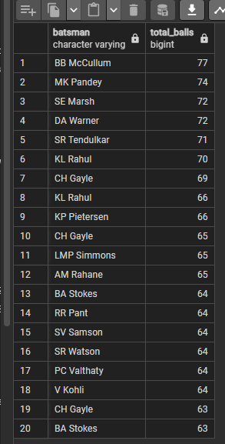
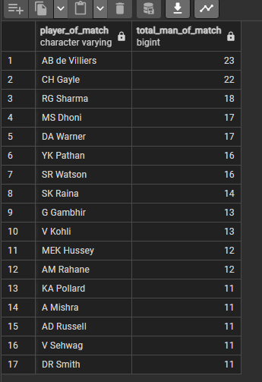
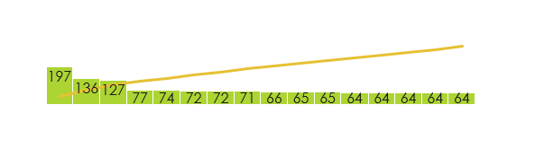
11. Any player with max players of match award as Man of Match.
SELECT player_of_match,count(id) TOTAL_Man_of_Match
FROM matches
GROUP BY player_of_match
HAVING count (player_of_match)> 10
ORDER BY count(id) DESC;
12. Balls taken to hit century Balls taken to hit century
SELECT batsman,count(batsman) total_balls
FROM deliveries
GROUP BY batsman,id
HAVING SUM(batsman_runs) >= 100
ORDER BY count(batsman) desc limit 20;

Slide 22
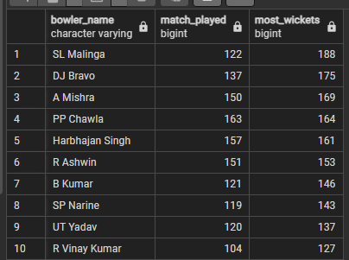
13. Top 10 bowler name by the played matches and took the wickets
SELECT bowler AS BOWLER_NAME,
COUNT(DISTINCT id) AS MATCH_PLAYED,
SUM(IS_WICKET) AS MOST_WICKETS
FROM deliveries WHERE over < 20
GROUP BY bowler
HAVING COUNT(over) >= 200
AND count(distinct id) >= 50
order by MOST_WICKETS desc
limit 10;

Slide 23
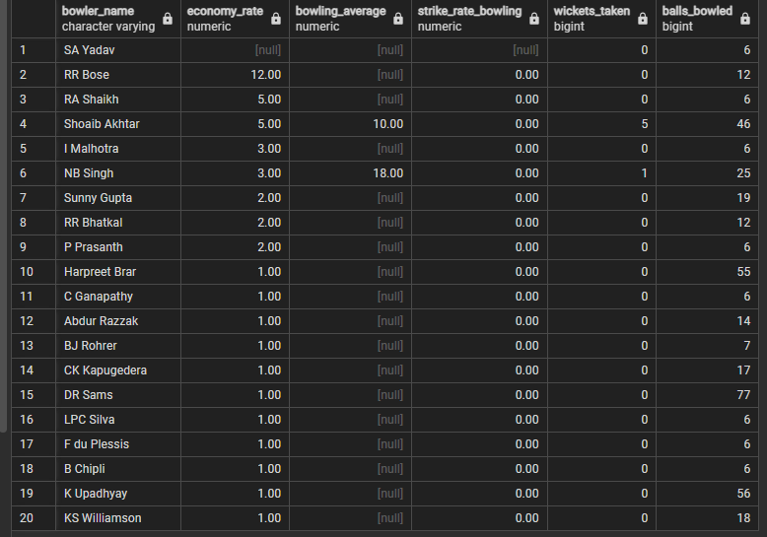
14. Top 20 Bowlers of economy rate, bowling average
stricke rate(bowling) wickets taken, balles bowled
SELECT bowler AS Bowler_Name,
ROUND(SUM(total_runs) / NULLIF(SUM(over) / 6, 0), 2) AS Economy_Rate,
ROUND(SUM(total_runs) / NULLIF(SUM(CASE WHEN is_wicket = '1' THEN 1 ELSE 0 END), 0), 2) AS Bowling_Average,
ROUND((SUM(CASE WHEN is_wicket = '1' THEN 1 ELSE 0 END) / NULLIF(SUM(over) / 6, 0)), 2) AS Strike_Rate_Bowling,
SUM(CASE WHEN is_wicket = '1' THEN 1 ELSE 0 END) AS Wickets_Taken,
COUNT(ball) AS Balls_Bowled
FROM deliveries
GROUP BY bowler
ORDER BY Economy_Rate desc, Bowling_Average desc limit 20;

Slide 24

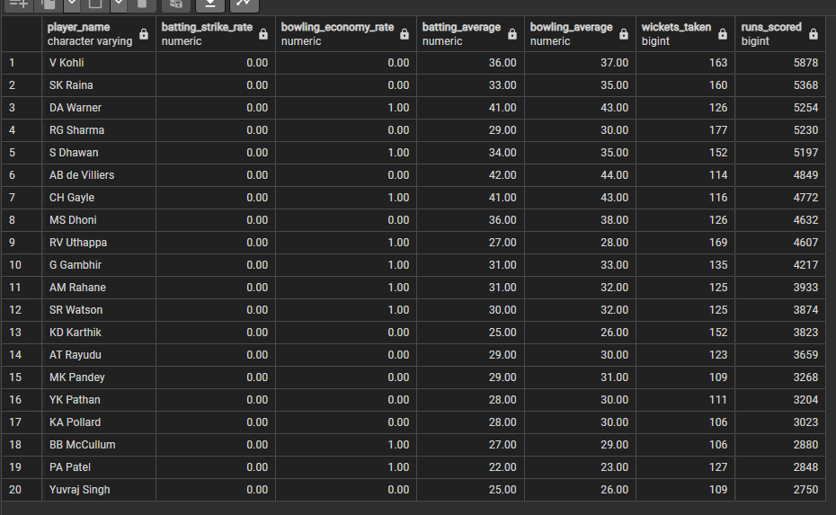
15. Top 20 All-rounders Batting strick rate, bowling economy rate, batting and bowling
averages, wicket taken, run scored
SELECT Player_Name, Batting_Strike_Rate, Bowling_Economy_Rate, Batting_Average,
Bowling_Average, Wickets_Taken, Runs_Scored
FROM (SELECT batsman AS Player_Name,
ROUND(SUM(batsman_runs) / NULLIF(SUM(ball), 0) * 100, 2) AS Batting_Strike_Rate,
ROUND(SUM(total_runs) / NULLIF(SUM(over) / 6, 0), 2) AS Bowling_Economy_Rate,
ROUND(SUM(batsman_runs) / NULLIF(COUNT(CASE WHEN is_wicket = '1' THEN 1 END), 0), 2) AS Batting_Average,
ROUND(SUM(total_runs) / NULLIF(SUM(CASE WHEN is_wicket = '1' THEN 1 END), 0), 2) AS Bowling_Average,
SUM(CASE WHEN is_wicket = '1' THEN 1 ELSE 0 END) AS Wickets_Taken,
SUM(batsman_runs) AS Runs_Scored
FROM deliveries
GROUP BY batsman) AS sub
order by batting_strike_rate, runs_scored desc
LIMIT 20;

Slide 26
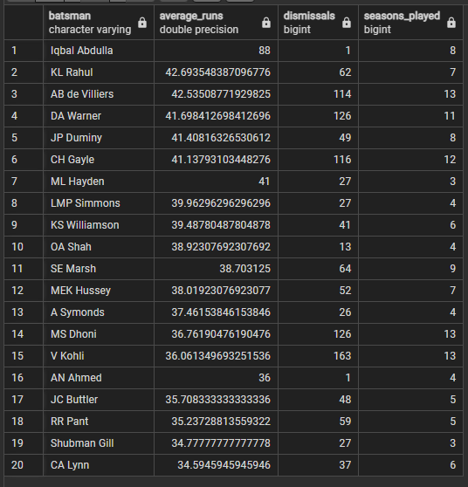
16. Top 20 with player good average played at least all IPL seasons.
SELECT b.batsman, CAST(SUM(b.batsman_runs) AS FLOAT) / COUNT(CASE WHEN b.is_wicket = 1 THEN 1 END) AS average_runs,
SUM(b.is_wicket) AS dismissals,
COUNT(DISTINCT(EXTRACT(YEAR FROM m.date))) AS seasons_played FROM deliveries AS b INNER JOIN matches AS m
ON b.id = m.id
GROUP BY b.batsman
HAVING COUNT(CASE WHEN b.is_wicket = 1 THEN 1 END) >= 1 AND COUNT(DISTINCT(EXTRACT(YEAR FROM m.date))) > 2
ORDER BY average_runs desc
LIMIT 20;

Slide 27
Top 20 with player good average played at least all IPL seasons.

Slide 28

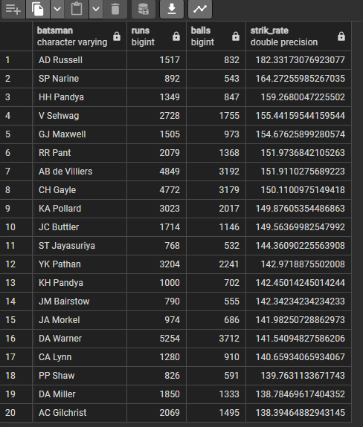
17. Top 20 highest strike rate
SELECT batsman, SUM(batsman_runs) AS runs, COUNT(ball) AS balls,
(CAST(SUM(batsman_runs) AS FLOAT) / COUNT(ball))*100 AS strik_rate
FROM deliveries
WHERE NOT (extras_type = 'wides')
GROUP BY batsman
HAVING COUNT(ball) >= 500
ORDER BY strik_rate desc
LIMIT 20;

Slide 29
Top 20 highest strike rate

Slide 30

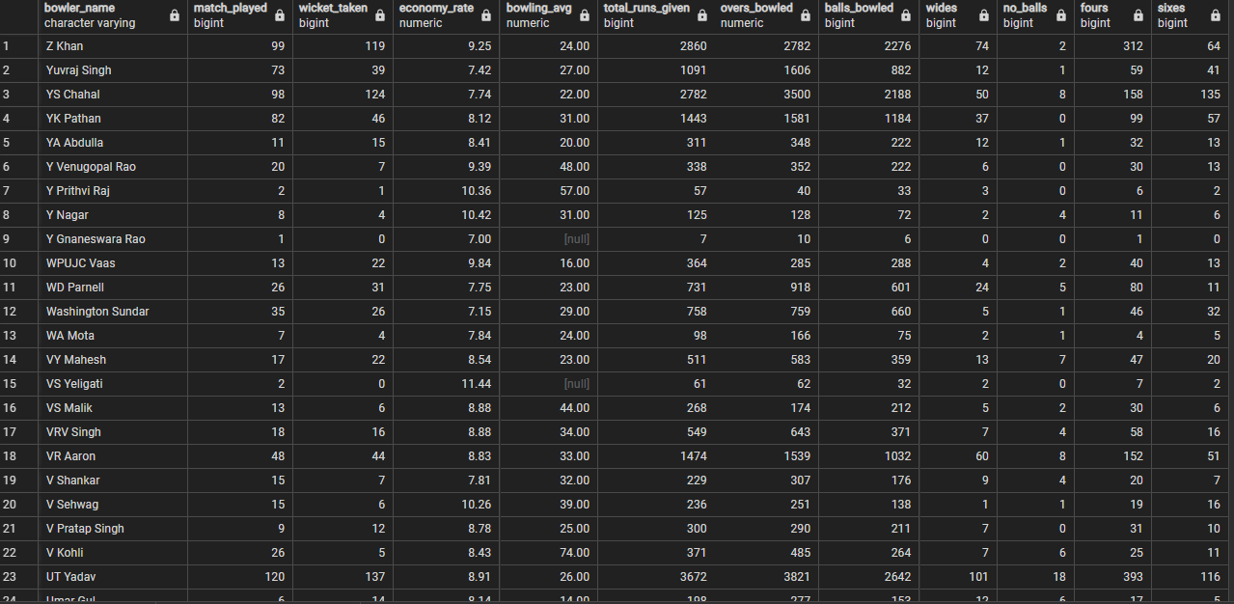
18. All Bowler who bowled in ipl with complete stets on name
SELECT bowler AS BOWLER_NAME,
COUNT(DISTINCT id) AS MATCH_PLAYED,
SUM(is_wicket) AS WICKET_TAKEN,
CASE WHEN SUM(CASE WHEN over > 0 THEN 1 ELSE 0 END) = 0 THEN NULL
ELSE ROUND(SUM(total_runs) / (SUM(CASE WHEN over > 0 THEN 1 ELSE 0 END) / 6.0), 2)
END AS ECONOMY_RATE,
ROUND(SUM(total_runs) / NULLIF(SUM(is_wicket), 0), 2) AS BOWLING_AVG,
SUM(total_runs) AS TOTAL_RUNS_GIVEN,
ROUND(SUM(over) / 6.0, 0) AS OVERS_BOWLED,
COUNT(ball) AS BALLS_BOWLED,
COUNT(CASE WHEN extras_type = 'wides' THEN 1 END) AS WIDES,
COUNT(CASE WHEN extras_type = 'noballs' THEN 1 END) AS NO_BALLS,
SUM(CASE WHEN batsman_runs = 4 THEN 1 ELSE 0 END) AS FOURS,
SUM(CASE WHEN batsman_runs = 6 THEN 1 ELSE 0 END) AS SIXES
FROM deliveries
GROUP BY bowler
ORDER BY bowler desc;

Slide 31

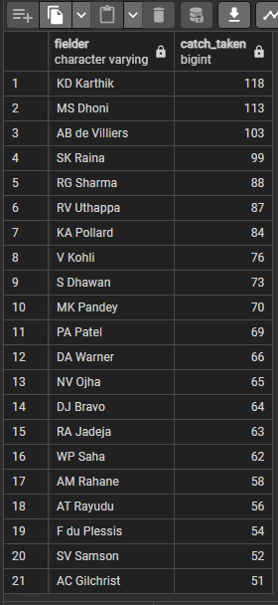
19. who has taken maximum catches.
select fielder,count(is_wicket) as catch_taken
from deliveries
where dismissal_kind = 'caught'
group by fielder
having count(fielder) >50
order by catch_taken desc;

Slide 32
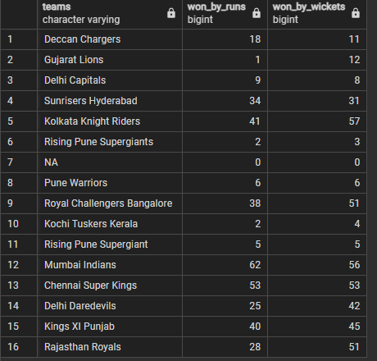
20. WINNER, RESULT BY RUNS OR WICKET
SELECT winner AS TEAMS,
SUM(CASE WHEN result = 'runs' THEN 1 ELSE 0 END) AS WON_BY_RUNS,
SUM(CASE WHEN result = 'wickets' THEN 1 ELSE 0 END) AS WON_BY_WICKETS
FROM MATCHES
GROUP BY WINNER
HAVING winner NOT IN ('runs' , 'wickets');

